Slide 1
HOUSING DATA ANALYSIS
Presented By:
G.Subash
DA/DS June Batch

Slide 2
Problem Statement
The housing market is highly dynamic, and it is often difficult to estimate property
values accurately. Buyers may overpay, sellers may undervalue their homes, and
policymakers may lack insights into housing affordability.
There is a need for data-driven analysis to understand the factors affecting housing
prices and to predict property values effectively.
Variations in property attributes across different regions.
Difficulty in identifying which factors significantly impact housing prices.
Presence of irrelevant or inconsistent data in raw datasets.

Slide 3
Objectives
To clean and preprocess the housing dataset for accurate analysis.
To perform exploratory data analysis (EDA) and identify patterns in housing features.
To examine relationships between property attributes and prices.
To develop a regression model that can predict house prices based on key features.
To generate insights that help in better decision-making for buyers, sellers, and real estate professionals.

Slide 4
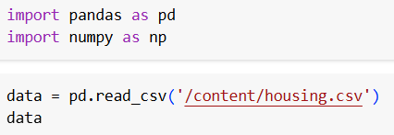


Data Understanding and Data Cleaning
Raw housing data may contain irrelevant, missing, or inconsistent values.
Cleaning ensures accuracy, reliability, and better model performance.
Removed irrelevant columns (Street, Statezip, Country) that do not impact price prediction.
Standardized features by creating new meaningful attributes:
House_Age = 2025 – yr_built
Price_per_sqft = price ÷ sqft_living
Checked and handled missing values.

Slide 5
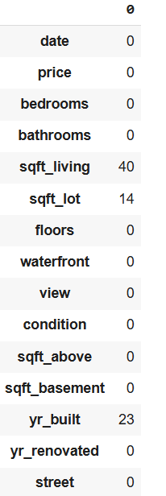
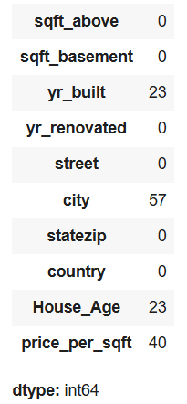
Handling Missing Values
Checked dataset using isnull().sum() to
identify missing values.
Found no significant missing values in
the dataset.
No imputation or deletion was required.

Slide 6
Statistical Analysis
Descriptive Statistics: Mean, median, standard deviation
of variables such as price, bedrooms, bathrooms, and square footage.
Correlation Analysis: Identified strong positive correlation
between sqft_living and price.
Regression Analysis: Applied Linear Regression to predict
house prices using square footage as the main feature.
Model Evaluation: Used R² score and Mean Squared Error (MSE)
to assess prediction accuracy.

Slide 7
Descriptive Statistics
Purpose: To summarize the main characteristics of the housing dataset and understand its distribution.
Key Statistics:
Price: Wide variation observed, with average price around the mid-range.
Bedrooms & Bathrooms: Most houses have 3–4 bedrooms and 2–3 bathrooms.
Sqft Living: Average living area is moderate, with a few very large properties (luxury outliers).
House Age: Range spans from newly built homes to houses over 100 years old.

Slide 8
Data Visualization
Histograms – to observe distribution of house prices.
Countplots – to analyze frequency of bedrooms and bathrooms.
Boxplots – to detect outliers in bathrooms, sqft_living, and price.
Scatter Plots – to study relationships such as sqft_living vs price.
Heatmaps – to visualize correlation among features (bedrooms, bathrooms, sqft_living, floors, price).

Slide 9
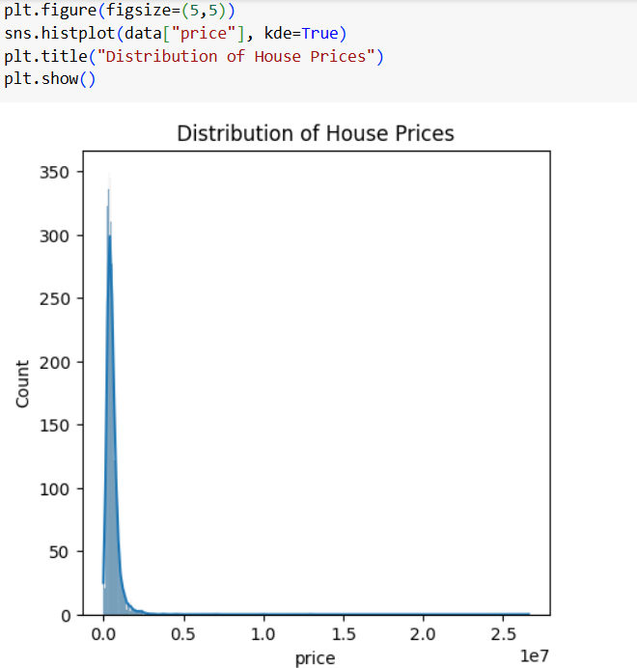
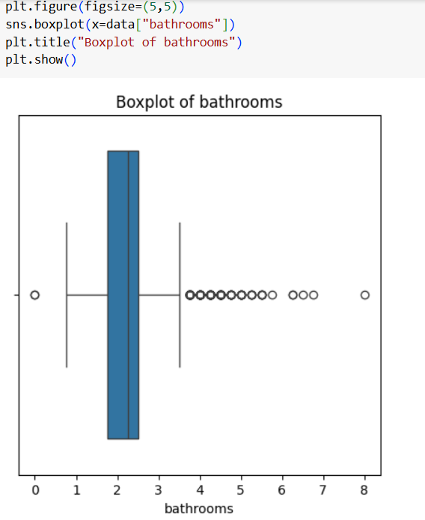
Univariate Analysis
Histplot for house price
Boxplot for bathrooms

Slide 10
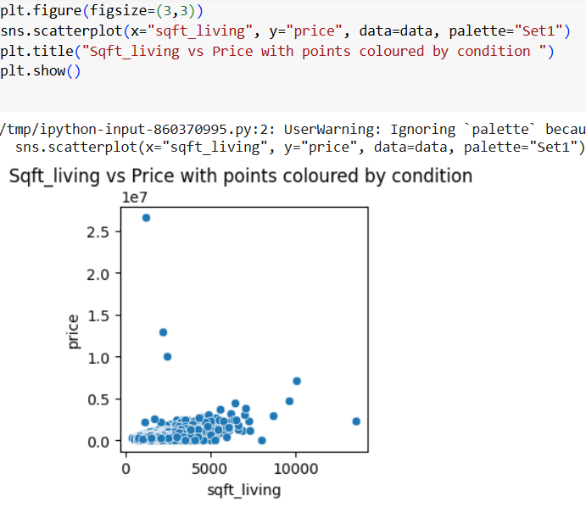
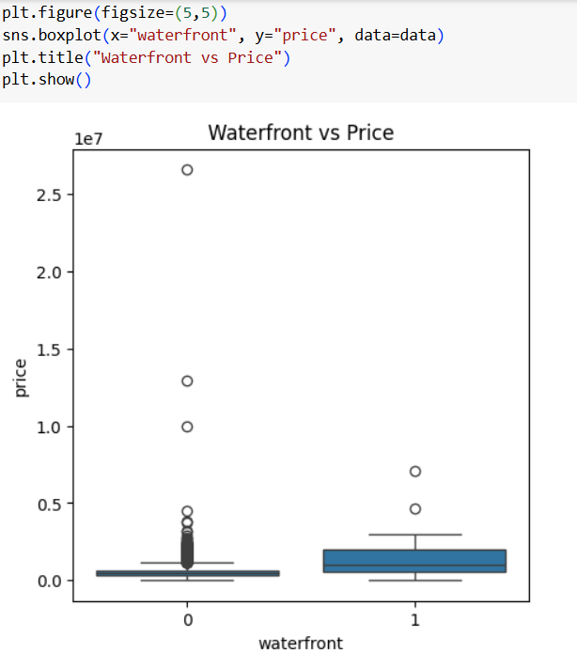
Bivariant Analysis
Scatterplot
Boxplot

Slide 11
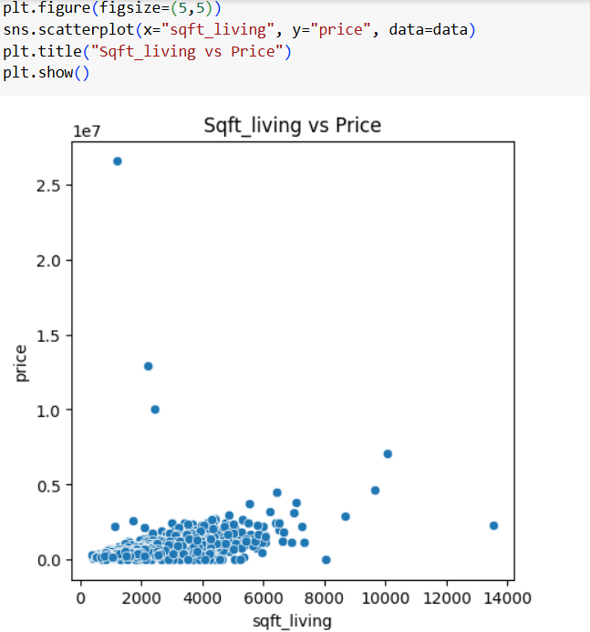
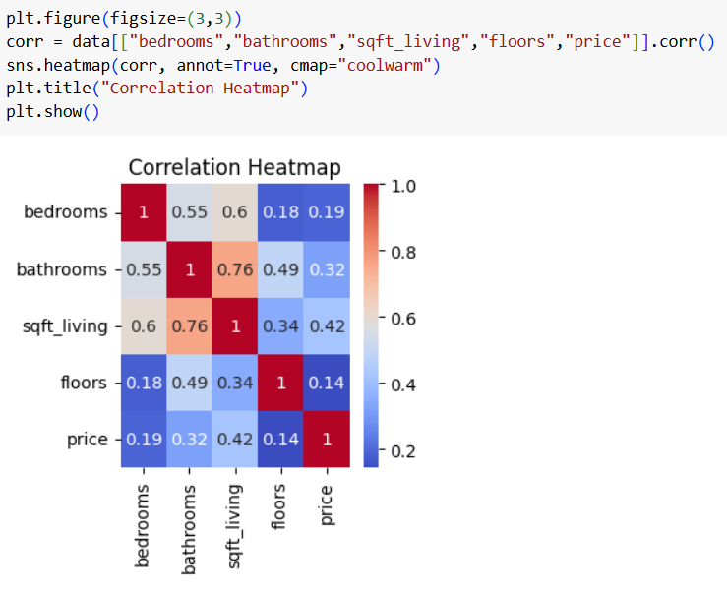
Multivariate Analysis
Scatterplot
Heatmap

Slide 12
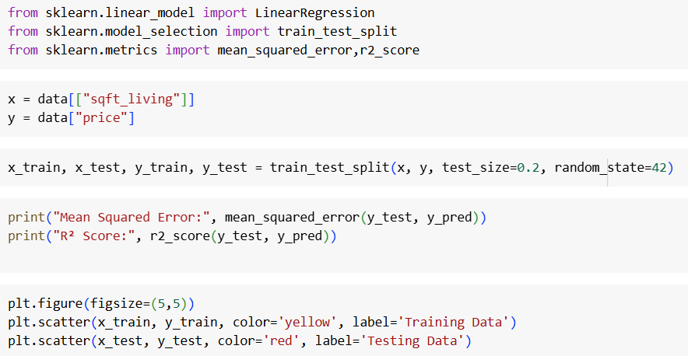
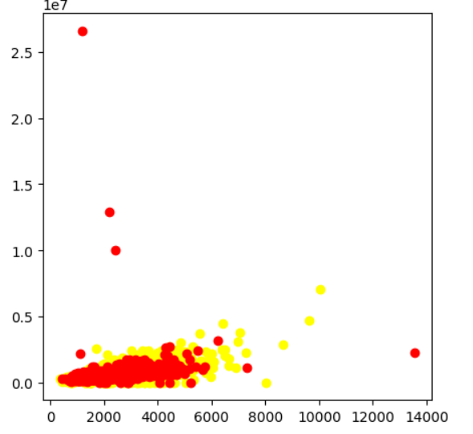
Linear Regression

Slide 13
Conclusion
The housing dataset was successfully cleaned, analyzed, and modeled.
Descriptive analysis showed most houses have 3–4 bedrooms and prices are skewed with luxury outliers.
EDA revealed:
sqft_living strongly influences house prices.
Waterfront properties significantly increase price.
Some features (like number of bedrooms alone) have weaker impact.
Linear Regression model confirmed a strong positive relationship between square footage and price.
Recommendations:
Buyers should focus on house size and location features (like waterfront) when evaluating property value.
Sellers can highlight square footage and location benefits to improve market value.
Policymakers and real estate professionals can use data-driven insights for better housing market predictions

Slide 14
THANK YOU

